Slide 2
A Simple Guide for Moving Your Content Systems to the Cloud
All you need to know in 12-15 minutes.
Or at least enough to get you started

Slide 3
Raoul Miller
Director, Content Strategy and Advisory
TEAM IM
raoul.miller@teamim.com
@ECM_Raoul

Slide 4


TEAM IM
Content and unstructured data specialists since 1999
Oracle, M-Files, Microsoft, Elasticsearch, HelloSign, Frevvo, ABBYY, Smartlogic partners
Operate in US, Canada, Australia and New Zealand
Advisory and Strategy practice is one part of what we do.
© Raoul Miller

Slide 5
High Speed Agenda
Cloud basics and terminology
Cloud services landscape
How to choose a cloud platform
Addressing objections
Next steps
© Raoul Miller

Slide 6
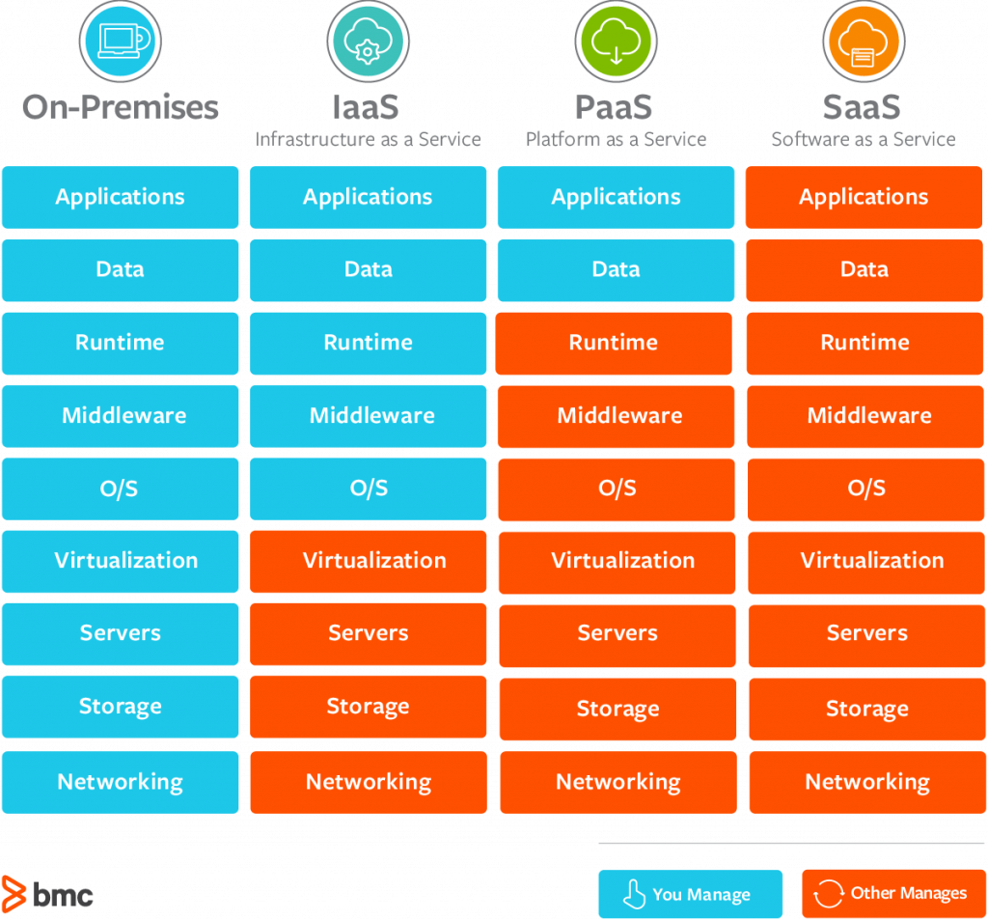
Cloud Basics and Terminology
It’s all about control
Infrastructure (IaaS)
Platform (PaaS)
Software (SaaS)
https://www.bmc.com/blogs/saas-vs-paas-vs-iaas-whats-the-difference-and-how-to-choose/

Slide 7
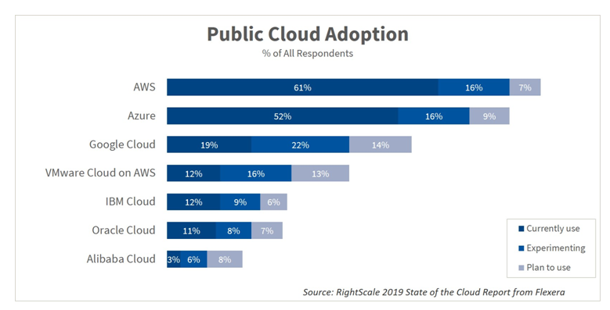
Cloud Services Landscape
Major IaaS / PaaS providers
Amazon Web Services
Microsoft Azure
Google
SaaS more complicated
You need a plan

Slide 8
How To Choose a Cloud Platform
What is your existing tech footprint?
What is your current level of expertise?
What are you using already?
Multi cloud?
Data residency

Slide 9

Addressing Objections
Security
Data residency
Connections to other systems
Cost
Complexity
© Raoul Miller

Slide 10

Next Steps
Start small
Talk to the business / stakeholders
Assess your capabilities honestly
Make a plan and a business case
(Photo: Evan Forester/Creative Commons)

Slide 11
“Cloud is about how you do computing, not where you do computing.”
‘’
-- Paul Maritz, CEO
VMWare

Slide 12
Questions?
Raoul Miller
Director, Content Strategy and Advisory
TEAM IM
raoul.miller@teamim.com
@ECM_Raoul (Twitter)

